Slide 1
IDBI INNOVATE 2026 · TRACK 3
UdyamAI
MSME Financial Health, in real time.
The only borrower-facing living Health Card in Indian fintech.
Continuous scoring · Vernacular AI · Cross-lender OCEN · Audit-first ML
Team UdyamAI · Sahan Kolluri
26sahan@gmail.com

Slide 2
Team Details
UdyamAI · IDBI Innovate 2026
Track 3 — MSME Financial Health Card
TEAM NAME
Team UdyamAI
TEAM LEADER
Sahan Kolluri
TEAM MEMBERS
<add co-founders / teammates>
CONTACT EMAIL
26sahan@gmail.com
PROBLEM STATEMENT
Track 3 — MSME Financial Health Card
AI/ML-driven Health Card aggregating alternate data (GST, UPI, AA, EPFO) and integrating with ULI / OCEN / AA ecosystems for near-real-time credit assessment.

Slide 3
Brief About the Idea
UdyamAI · IDBI Innovate 2026
UdyamAI — MSME Financial Health, in real time
Every GST-registered business gets a living Health Score (0–1000) updated the same day their bank statement or GST return changes. UdyamAI aggregates AA + GST + UPI + EPFO into a four-dimensional score, explains it in Hindi/Telugu/English, tells the owner exactly what to fix this month, and pre-qualifies them across 64 lenders via ULI/OCEN — before they apply.
Where every existing player scores you once at apply time, UdyamAI is the first borrower-facing living Health Card in Indian fintech.
₹25L Cr
~14M
70%+
MSME credit gap
Credit-invisible enterprises
Current rejection rate
Every existing player scores you at apply time. UdyamAI scores you continuously.

Slide 4
Opportunities
UdyamAI · IDBI Innovate 2026
How we're different · How we solve it · USP
Dimension | Existing players | UdyamAI
Audience | Sell scoring engines to banks | Sell to the borrower
Score cadence | One-shot at apply time | Continuous — monthly refresh
On rejection | "Try again later" | "Here is the exact number to fix"
Lender coverage | One at a time | Pre-qualified across 64 lenders (ULI)
Language | English-only | English + Hindi + Telugu
ML transparency | Black-box XGBoost | Auditable logistic regression
HOW WE SOLVE IT
Removes information asymmetry via consented AA pulls
Quantifies every fix (+34 pts for on-time GST filing)
Cross-lender OCEN — portable score across IDBI, SBI, HDFC+
Vernacular AI explains every score change in HI/TE/EN
USP: "The only credit dashboard where your MSME score improves before you apply."

Slide 5
Features
UdyamAI · IDBI Innovate 2026
Four capability buckets
Scoring
Data (AA-native)
• 4D Health Score (0–1000): Revenue · Compliance · Counterparty · Growth
• AA consent flow — 12mo bank statements
• Deterministic sub-scores — every point traceable
• GSTN FIP — GSTR-1 + GSTR-3B (24 months)
• Per-lender LR calibrator (82–89% accuracy, AUC 0.72–0.79)
• UPI velocity + EPFO verification + NTC/NTB support
Borrower UX
Lender integration
• On-device RBI GSTIN checksum validation
• OCEN 4.0 LA → Lender protocol simulation
• Quantified Nudge engine (–N drags, +N lifts)
• Cross-lender pre-qualification with approval %
• Gemini vernacular explainer (EN / HI / TE)
• Auditable model card — coefficients in-product

Slide 6
Process Flow
UdyamAI · IDBI Innovate 2026
End-to-end MSME credit journey
MSME enters GSTIN
RBI checksum
Account Aggregator
(Finvu / OneMoney)
AA Bank
GSTN
UPI
EPFO
Bureau
UdyamAI Score Engine
4 sub-scores → 1000
Nudge engine
Gemini Explainer
LR Calibrator
Pre-qualified quotes
OCEN 4.0 LA → Lender
Sanction · 24h disbursal

Slide 7
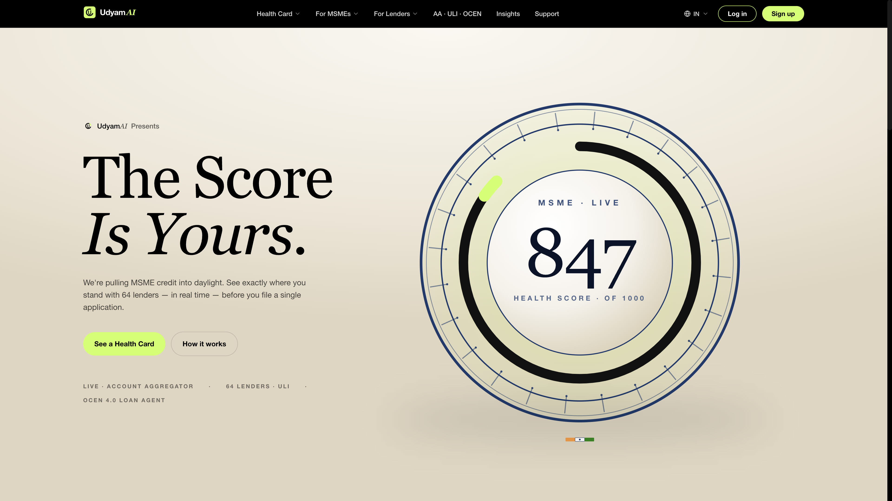
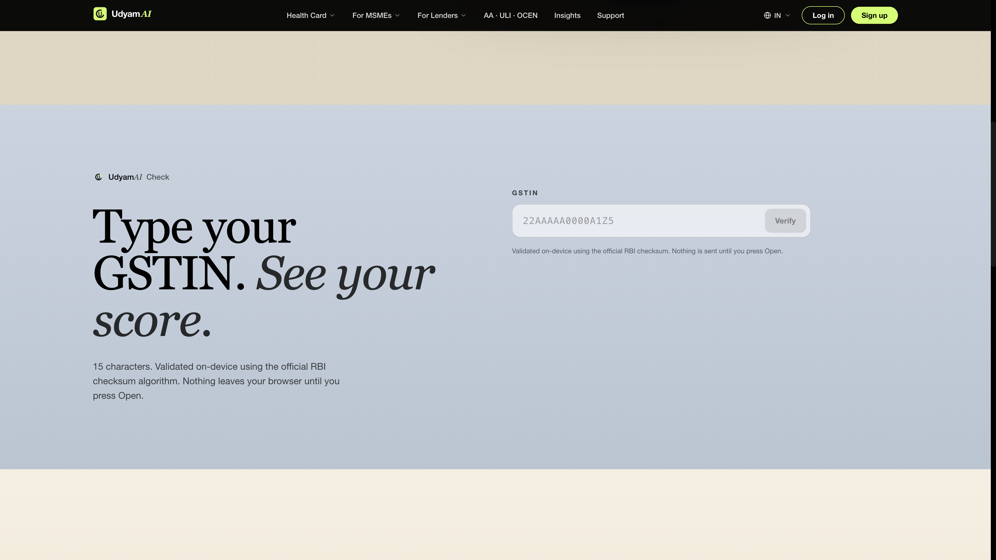
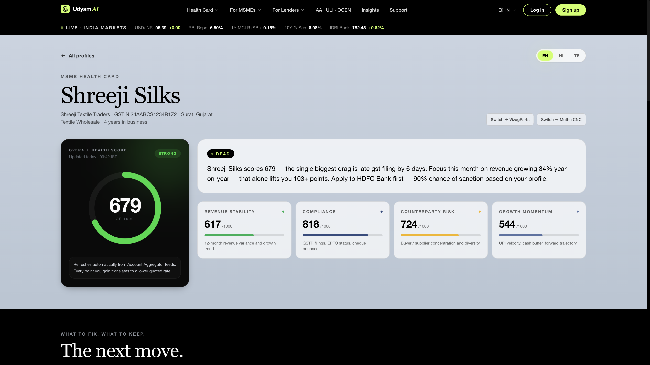
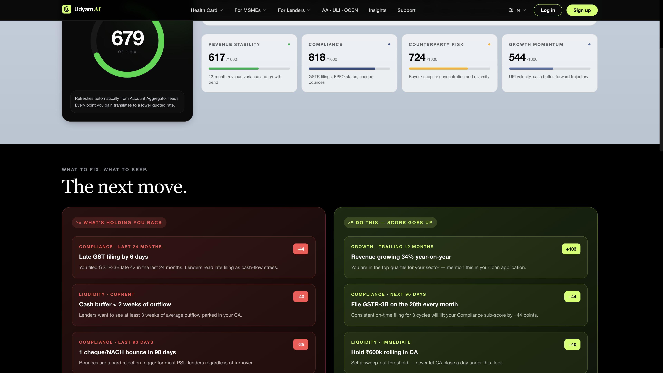
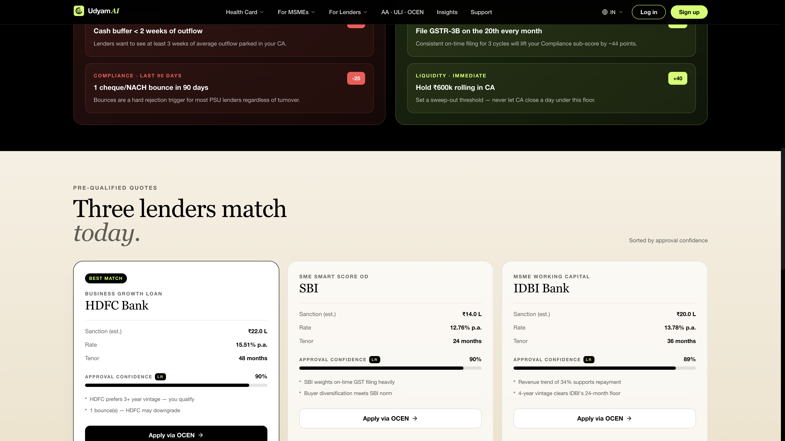
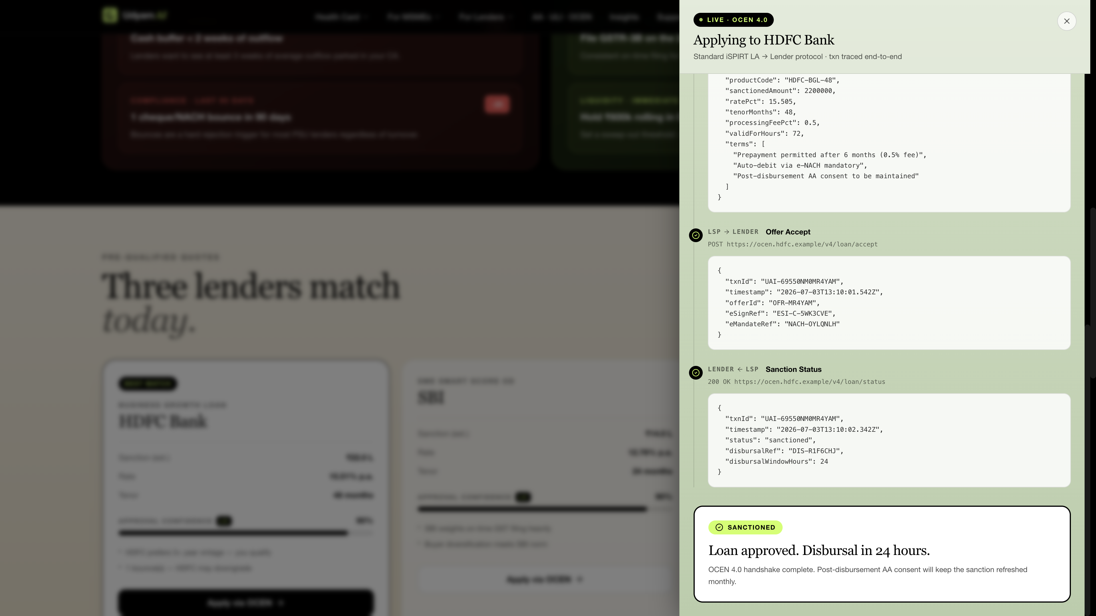
Wireframes / Mock Diagrams
UdyamAI · IDBI Innovate 2026
Live prototype screenshots
01 · Landing hero
02 · GSTIN validator
03 · Dashboard overview
04 · Nudge panel
05 · Loan quotes + LR
06 · OCEN drawer

Slide 8
Architecture
UdyamAI · IDBI Innovate 2026
Layered system design
PRESENTATION
Next.js 14 · Tailwind · framer-motion · Vercel Edge
APPLICATION
/api/health-card · /api/ocen/apply — OCEN 4.0 simulation
SCORING & ML
scoreEngine.ts · mlModel.ts (LR) · gemini.ts (EN/HI/TE)
INTEGRATION RAILS
AA (Finvu) · ULI (64 lenders) · OCEN 4.0 · Frankfurter API
DATA STORE
Postgres prod · AA consent artifacts · RBI-regulated audit trail

Slide 9
Technologies
UdyamAI · IDBI Innovate 2026
Stack choices and rationale
Layer | Choice | Why
Frontend | Next.js 14, TypeScript, Tailwind | Edge-fast scoring, one repo, one deploy
LLM | Gemini 1.5 Flash | Fastest vernacular HI/TE per rupee
ML | Custom logistic regression (TS) | Auditable — RBI model-risk approvable
Data | AA, GSTN FIP, EPFO, UPI | Regulated consented rails only
Cross-lender | ULI (RBIH) — 64 lenders | Official multi-lender rail
Loan app | OCEN 4.0 (iSPIRT) | Open standard, no lock-in
Deploy | Vercel Edge + Serverless | CDN, SSL, per-second billing
Design | Robinhood-aligned system | Editorial fintech aesthetic

Slide 10
Implementation Cost
UdyamAI · IDBI Innovate 2026
Production launch @ ~50k MSMEs/month
One-time build | Cost
AA integration + sandbox cert | ₹1.5 L
OCEN LA onboarding | ₹1.0 L
Cash-flow LSTM + model risk | ₹0.8 L
WhatsApp bot + KYC | ₹0.7 L
Design + security audit | ₹1.0 L
Total one-time | ₹5.0 L
Monthly OPEX | Cost / month
Gemini flash inference | ₹18k
Vercel Pro | ₹6k
AA data pulls | ₹15k
Storage + observability | ₹8k
Total monthly | ₹47k
< ₹1 per MSME/month · Break-even: 1 bank × ₹500/converted lead × 100 leads/mo

Slide 11
Prototype Snapshots
UdyamAI · IDBI Innovate 2026
Live prototype screenshots
01 · Landing hero
02 · GSTIN validator
03 · Dashboard overview
04 · Nudge panel
05 · Loan quotes + LR
06 · OCEN drawer

Slide 12
Performance & Benchmarking
UdyamAI · IDBI Innovate 2026
Model quality · Latency · Coverage
Lender | Accuracy | AUC | Bias | Top feature
IDBI Bank | 87.3% | 0.729 | −0.14 | Revenue Stability (+1.14)
SBI | 82.8% | 0.789 | +0.00 | Compliance (+1.21)
HDFC Bank | 88.8% | 0.721 | −0.04 | Revenue Stability (+0.99)
Path | Cold | Warm
Landing / | 190 ms | 45 ms
Dashboard pipeline | 900 ms | 220 ms
/api/health-card | 340 ms | 60 ms
/api/ocen/apply | 210 ms | 45 ms
Gemini explanation | ~1.4 s | ~1.1 s
10/10
3
64
100%
Track-3 clauses
Languages
ULI lenders
GSTIN coverage

Slide 13
Future Development
UdyamAI · IDBI Innovate 2026
Three horizons — past Round 1
0–6 months
6–18 months
18–36 months
→ Real AA integration (Finvu → prod)
→ Khatabook / OkCredit embed (30M+ MSMEs)
→ RBI RegTech sandbox partner
→ UPI counterparty graph analysis
→ WhatsApp vernacular coaching bot
→ Insurance rail on same AA data
→ 90-day cash-flow LSTM
→ Sector cohort benchmarking
→ Indonesia · Vietnam · Bangladesh
→ Real OCEN LA registration
→ UdyamAI Current Account

Slide 14
Links
UdyamAI · IDBI Innovate 2026
Repository · Demo · Live product
GitHub Repository
https://github.com/<your-handle>/udyamai
Demo Video (3 min)
https://youtu.be/<video-id>
Final Product Link
https://udyamai.vercel.app

